Slide 1
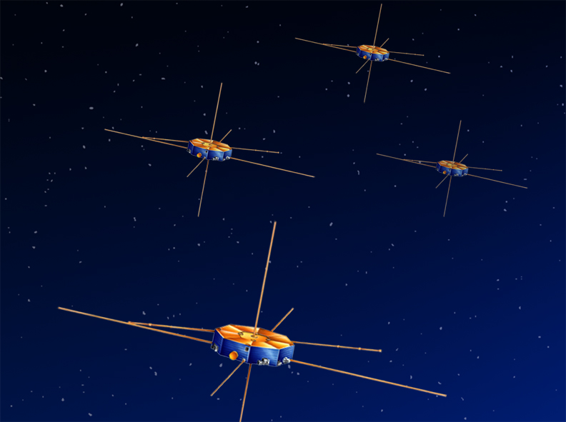
Data Analysis on Dual Electron Spectrometers (DES)
Fast Plasma Investigation – Magnetospheric Multi-Scale
Nicholas Shields – The Catholic University of America

Slide 2
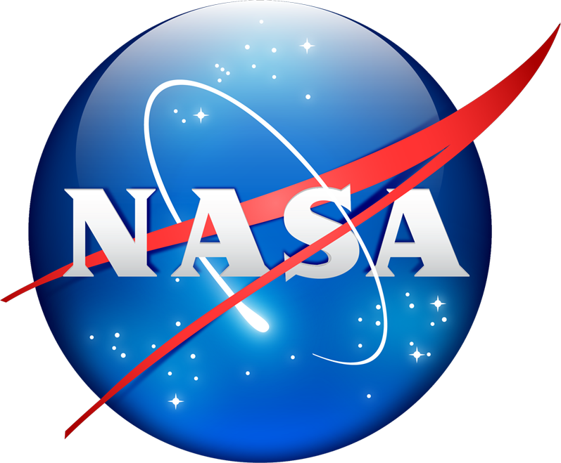
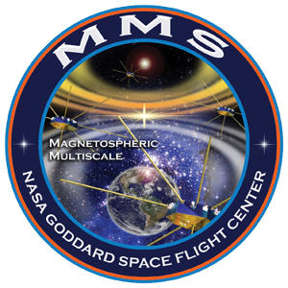
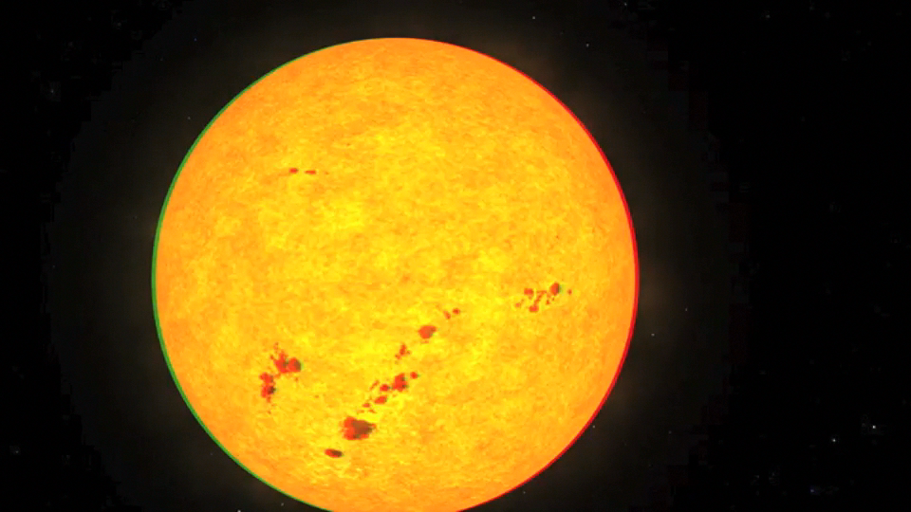
Magnetospheric Multi-Scale Mission
Scientific Target of Mission – Magnetic Reconnection
Notes:
between two magnetic fields
2 orbits dayside and nightside/tail
10 km diffusion --- electrons demagnetized – however the region will sweep over spacecraft at speeds up to 50 km/s

Slide 3
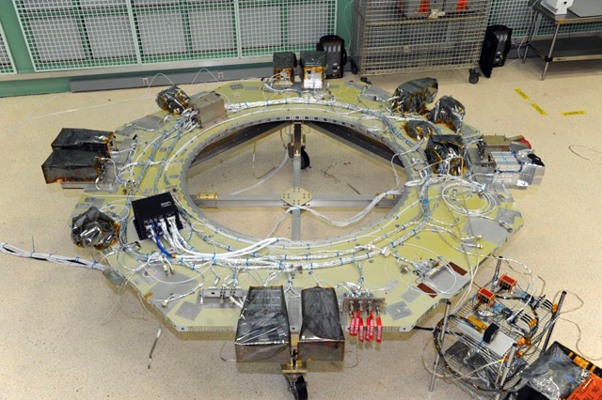
Fast Plasma Investigation
Fast Plasma Investigation –
Dual Electron Spectrometer (DES) and Dual Ion Spectrometer (DIS) measure respective distributions
Instrument Data Processing Unit (IDPU)
Notes:
10 km diffusion --- electrons demagnetized – however the region will sweep over spacecraft at speeds up to 50 km/s

Slide 4
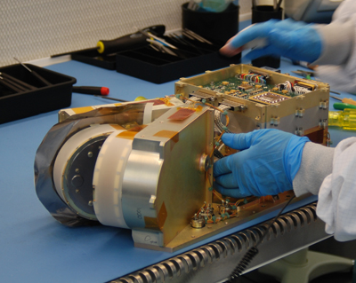
Dual Electron Spectrometer (DES)
Older models record distributions in 3 sec
New model provides a 3D electron velocity distribution in 30 ms
10 eV to 30,000 eV
Combines measurements from 16 DES’s over the four spacecraft
Measurements - angle/pixel
Goal – develop calibration and operation of these instruments.

Slide 5
Data Analysis on MMS/FPI Dual Electron Spectrometers (DES)
Magnetospheric MultiScale Mission (MMS)
Fast Plasma Investigation (FPI)
Dual Electron Spectrometer (DES)
Optical Parameter Fits
Virtual Instrument
HVPS Settling Times
Summer Work:
Optical Parameters – Fits
Interpolate expected energy ranges in order to produce a complete stepper table
HVPS Settling Times – DES and DIS
Fitting
Range change synchronization
Virtual instrument – implications and functionalities

Slide 6
Data Analysis on MMS/FPI Dual Electron Spectrometers (DES)
Optical Parameters – Fits
Interpolate/Extrapolate expected values at varied energies in order to produce a complete stepper table
Some of these parameters included:
analyzer constant;
anode to anode crosstalk;
azimuth angle FWHM;
azimuth angle offset;
dE/E;
gain;
geometric factor;
pixel to pixel crosstalk;
scattering crosstalk;
signal loss.

Slide 7
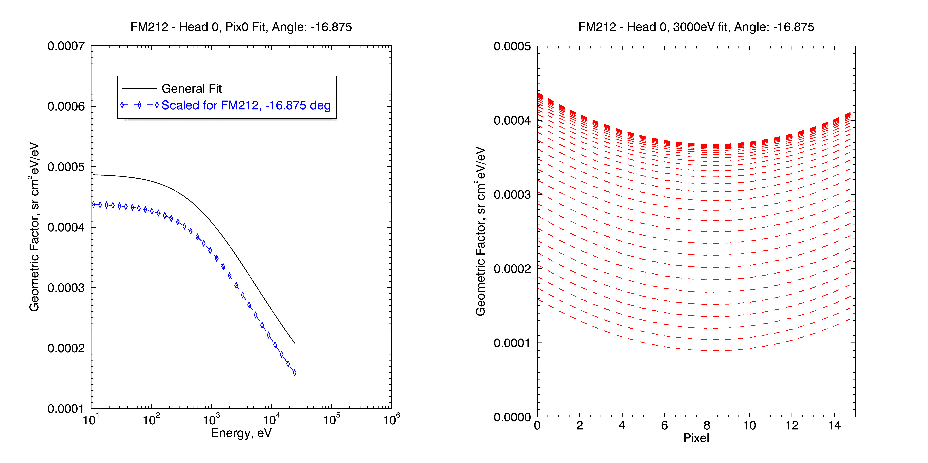
Data Analysis on MMS/FPI Dual Electron Spectrometers (DES)
Notes:
DEPENDENCE
pixel 0 and pixel 7 - general exponential fit over all units
Scaled per unit using the amplitude
A second order polynomial fit was done over the 3000eV data per angle per unit and then scaled to the marked energies in plot 1.

Slide 8
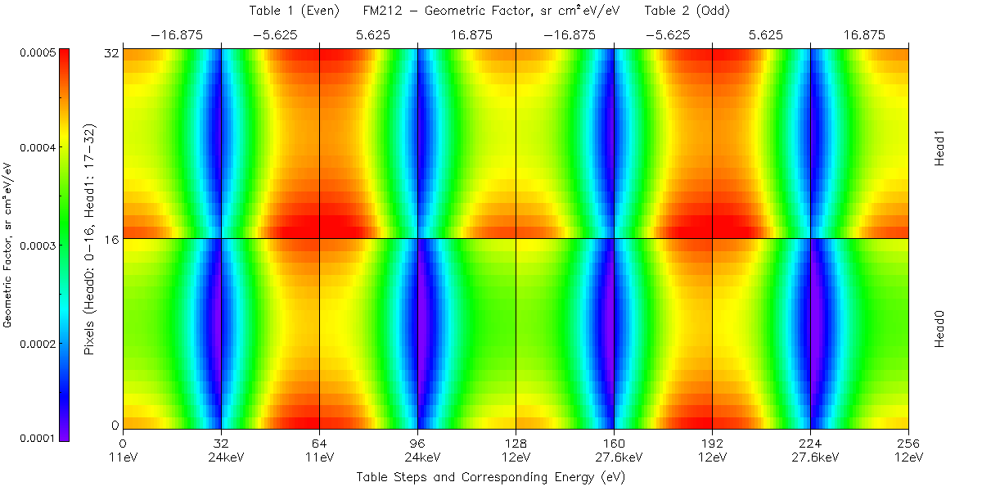
Data Analysis on MMS/FPI Dual Electron Spectrometers (DES)
Notes:
This map shows the geometric factor data for both heads of the FM212 unit, which should operate similarly but must be calibrated individually. Head 0/Head 1 and pixel are depicted horizontally, while the even/odd stepper tables and the four angles are displayed vertically. Notice that for either head, the geometric factor for the even and odd tables is very similar.

Slide 9
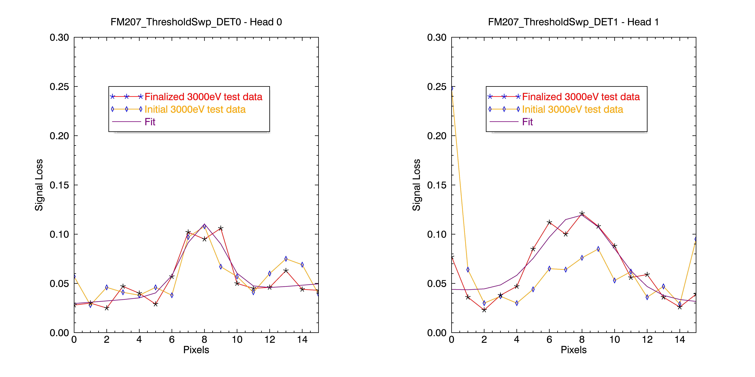
Data Analysis on MMS/FPI Dual Electron Spectrometers (DES)
Notes:
ONLY DEPENDENT ON PIXEL.
Signal Loss was fit with a Gaussian Fit. Due to some inconsistencies in the test data, we eliminated points that did not appear in multiple tests based on a standard deviation filter. If a point was removed the fit was done over an average of the two surrounding points.

Slide 10
Data Analysis on MMS/FPI Dual Electron Spectrometers (DES)
High Voltage Power Supply (HVPS) Settling Times – DES and DIS
Fitting
Notes:
The time required for the response curve to reach and stay within a percentage of the final value

Slide 11
Data Analysis on MMS/FPI Dual Electron Spectrometers (DES)
High Voltage Power Supply (HVPS) Settling Times
Range change synchronization - DES
Deflector shifts between low and high range
Notes:
DES – occurs ~50eV
DIS – occurs ~60eV

Slide 12
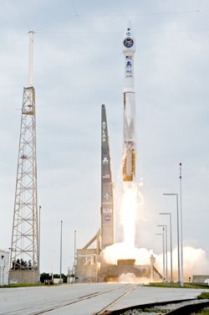
Data Analysis on MMS/FPI Dual Electron Spectrometers (DES)
ATLAS V 421 Launch Vehicle
Virtual Instrument
VI package currently being created using Python
Purpose
Test possible changes to the instrument calibration before implementation
Created a Spectrometer Fitting class that can implement fitting routines developed this summer
Future Work
Address optical parameters for DIS
Address range change for DIS
Continue to develop VI
Launch Date: October 2014

Slide 13
Magnetospheric Multi-Scale Mission
Thank you to:
Alex Barrie
Craig Pollock
Levon Avanov
CUA Physics Department

